Slide 1


Water–Energy Nexus in Hospitals and Communities
Understanding the Interconnection Between Water and Energy Systems
NBi3S Summer School 2026
Group 3:
Farnoosh Rostami, Politecnico di Milano
Junghwa Kim KR Alumni-UCL
Marin Andreea-Raluca RO UNITBV
Līga Blumfelde, University of Latvia (UL) and Riga Technical University (RTU)

Slide 2
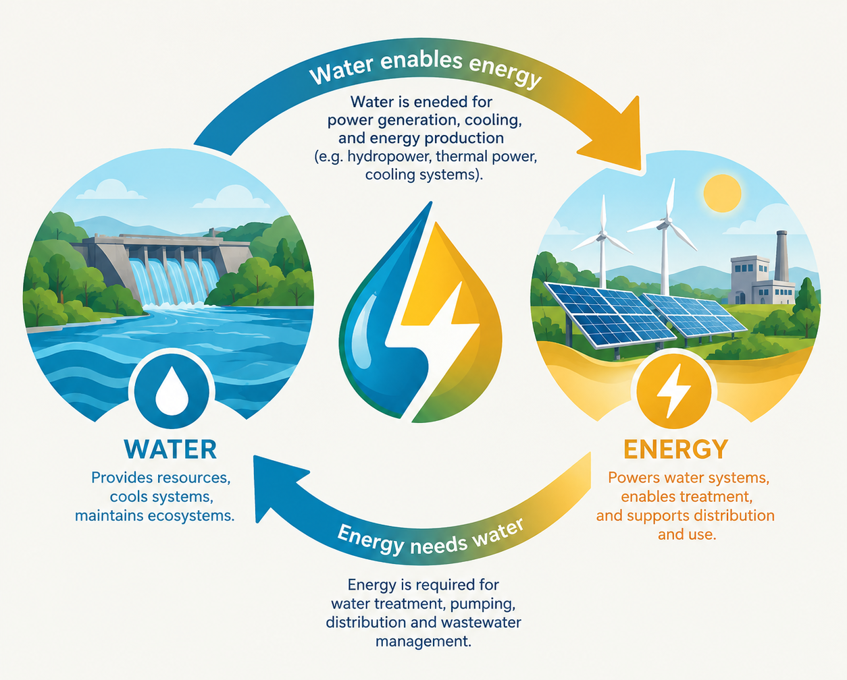



The Water–Energy Nexus: A Bidirectional Relationship
Water Requires Energy
Extraction, treatment, heating, and distribution all demand significant energy input at every stage.
Energy Requires Water
Power generation, cooling towers, and industrial processes consume vast quantities of water continuously.
The Opportunity
Wastewater contains recoverable heat that can be captured and reused instead of being lost to the environment.
Key Insight: Water and energy are fundamentally interconnected. Improving one without considering the other creates unintended consequences.

Slide 3
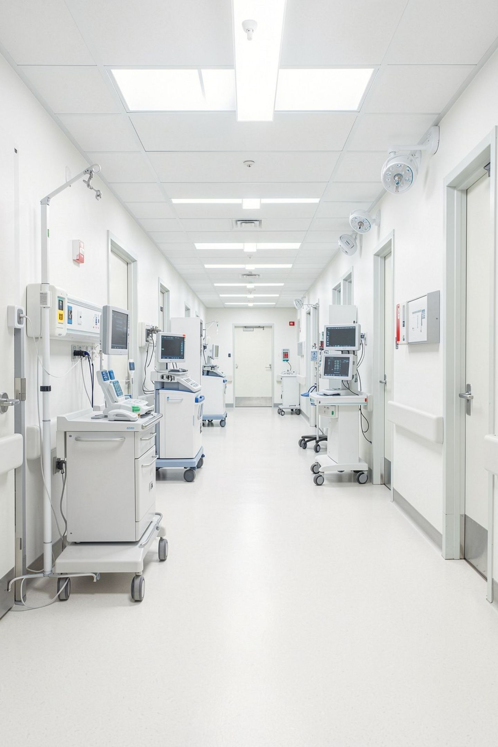
Why Hospitals Are Critical Examples
⏱ 24/7 Operation
Hospitals operate continuously with strict environmental control—unlike most commercial buildings.
⚡ Massive Consumption
10% of Europe commercial building energy and 3-8% of greenhouse gas emissions from hospitals alone.
🌡 HVAC Dominance
Heating, ventilation, and air conditioning consume 30–40% of hospital energy plus significant water for cooling.
💧 Wastewater Opportunity
Hospital wastewater is consistently warm from showers and sterilization—ideal for continuous heat recovery.

Slide 4
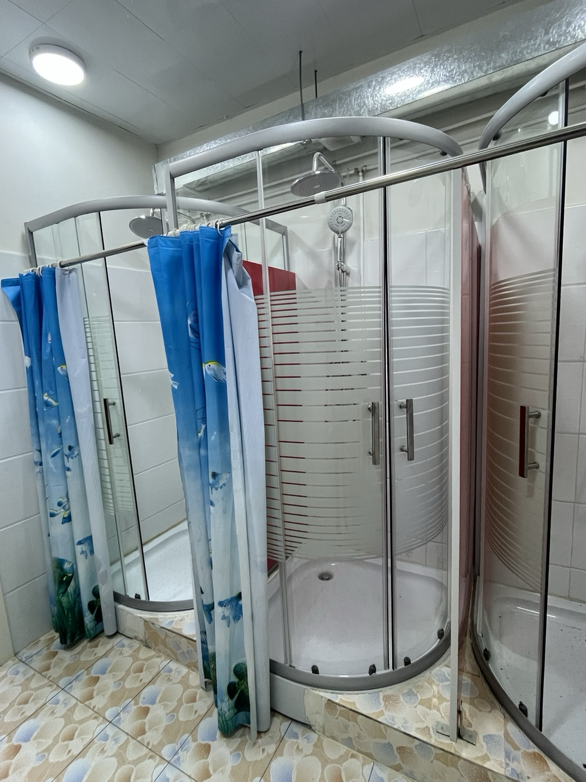
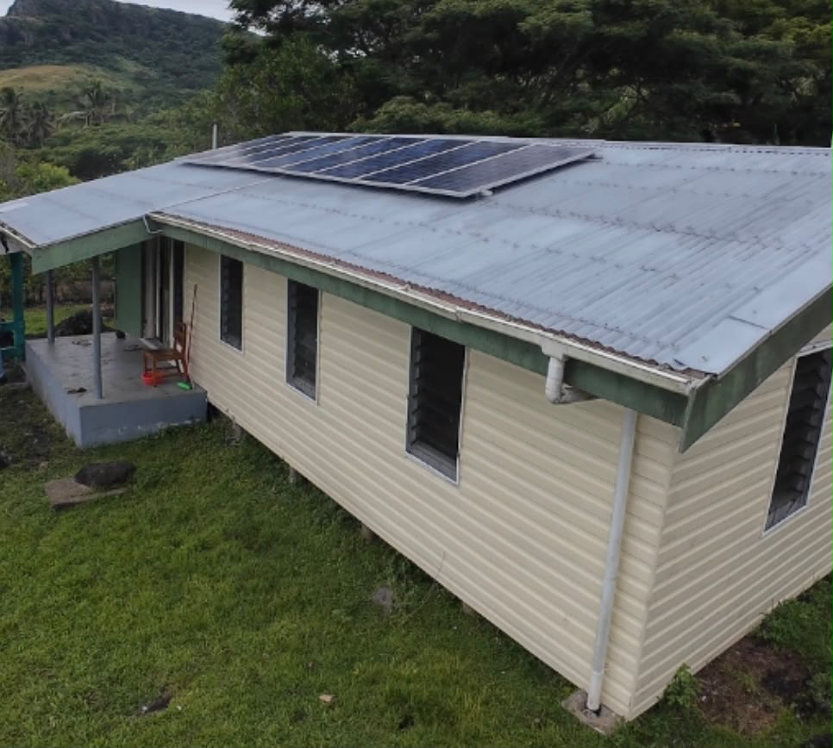
Case Study 1: Mongolia and Fiji
MONGOLIA
Fiji
Solar energy warms the water and the building
Solar and rainwater for reliable water supply and less electricity required

Slide 5



Case Study 2:
Hybrid PVT and Heat Pump System in a Tropical Hospital
The System
Water–Energy Connection: Renewable energy (water-free) replaces energy-intensive water-based cooling systems.
Photovoltaic thermal (PVT) panels produce both electricity and heat simultaneously. A heat pump uses this electricity to provide heating and cooling to hospital wards.
51–69%
0.5–3.9°C
The Innovation
Overall system efficiency combining electrical and thermal output
Reduction in hospital ward temperature achieved
Cooling the PVT panels improves their electrical efficiency while simultaneously providing useful space cooling—a genuine dual benefit from a single installation.
Solar Powered
Renewable energy drives both heating and cooling across the facility

Slide 6
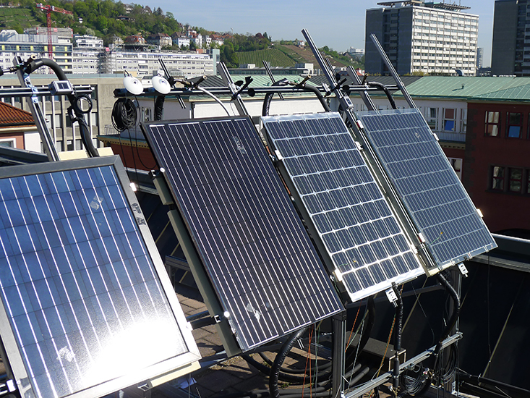
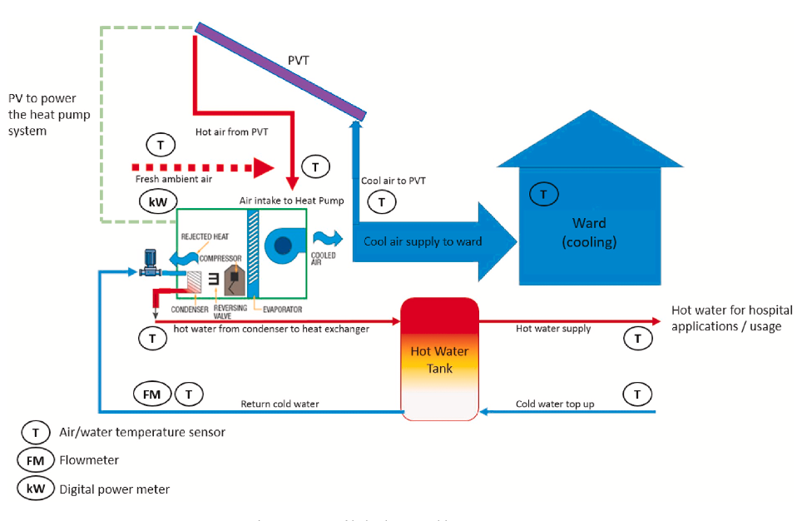
Case Study 2:
Hybrid PVT and Heat Pump System in a Tropical Hospital
Screenshot 2026-09-10

Slide 7
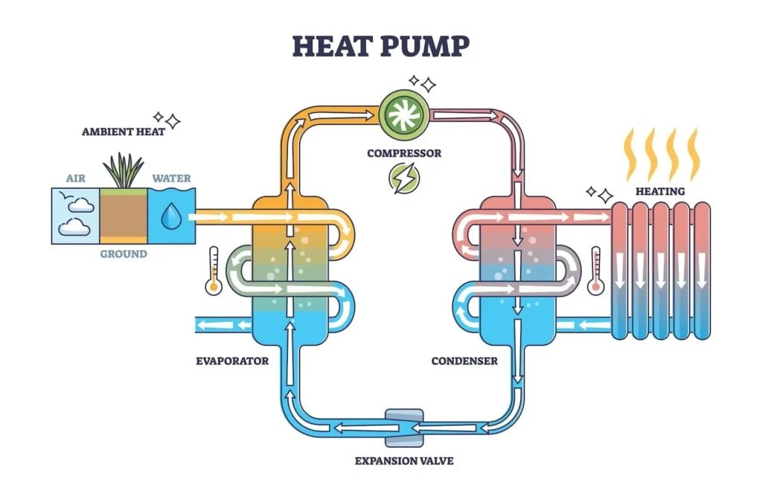

Technical Concepts: Heat Pumps and Heat Recovery
Core Components
Heat Pump
Heat Exchanger
Moves thermal energy from a cooler source to a warmer application using electricity as the driving force.
Transfers thermal energy between two fluids—like wastewater and a heating circuit—without mixing them.
COP (Coefficient of Performance)
A COP of 3.0 means 3 units of heat produced for every 1 unit of electricity consumed—three times more efficient than direct electric heating.
Key Insight: Heat pump technology is the bridge between waste heat sources and useful heating applications—making the nexus economically practical.

Slide 8
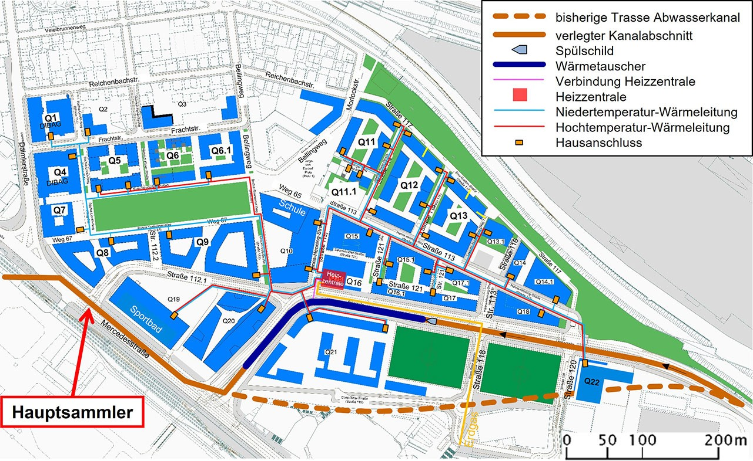
Case Study:
District Heating from Wastewater — Neckarpark, Stuttgart
Benchmark for sustainable energy supply in urban districts.
Municipal wastewater becomes the primary energy source for an entire urban district's heating network. With a thermal extraction capacity of 2,100 kW from wastewater - was by far the largest wastewater heat recovery project in Germany.
Heizzentrale (Red Square): Central heating plant.
Niedertemperatur-Wärmeleitung (Light Blue Lines): Trace these lines to show the low-temperature district heating network.
Hausanschluss (Yellow Dots): These indicate the individual house connections where the thermal energy enters the buildings.
Wärmetauscher (Dark Blue Line): Heat exchanger, which is installed directly in the sewer system.
Hauptsammler (Bottom Left): This is the main municipal wastewater collector providing the continuous flow of energy.

Slide 9





Designing for the Water–Energy Nexus
Design principle: Integrate water and energy systems from the beginning—separate design creates missed opportunities.
Heat Recovery
Heat exchangers in wastewater pipes and HVAC exhaust capture 30–50% of thermal energy
Efficient HVAC
Variable air volume systems and demand-controlled ventilation cut energy by 20–40%, water by 30–50%
Water Recycling
Wastewater reuse for flushing and cooling makeup reduces freshwater demand by 20–40%
District Systems
Centralized wastewater heat recovery supplies multiple buildings more efficiently than individual systems

Slide 10
Key Lessons and Path Forward
1
Integrated Design Is Essential
The Opportunity
Water and energy systems must be designed together to identify synergies and opportunities from the outset.
By understanding and acting on the Water–Energy Nexus, hospitals and communities can:
Dramatically reduce resource consumption
Lower operating costs over building lifetime
Advance sustainability and net-zero goals
Transform liabilities into renewable assets
2
Wastewater Is a Resource
Heat exchangers and heat pumps can capture and upgrade thermal energy from warm wastewater—recovering 30–50% of heat otherwise lost.
Renewable energy integration through solar thermal and photovoltaic systems can contribute 30–60% of building energy in sunny climates—complementing nexus strategies at every scale.
3
Scale Amplifies Benefits
District-scale systems like Neckarpark are more efficient than individual building systems and leverage shared infrastructure.
4
Circular Economy Approach
Treating wastewater and waste heat as resources aligns with sustainability principles and reduces environmental impact.

Slide 11
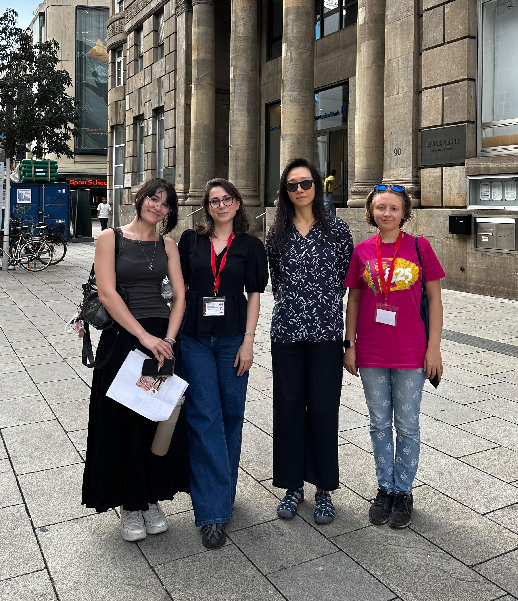
Thank you for your attention.
از توجه شما ممنونم.
감사합니다
Vă mulțumim pentru atenție!
Paldies par uzmanību!

